Slide 1
Convolutional Neural Networks: Malaria Detection
Patrick Parsa • 10.26.2021

Slide 2
Overview
The Data
Base Model
Alterations to Model
Keras Tuner
Pre-Trained Model (vgg16)
Alterations to Images
Image Augmentation
Grayscale conversion
HSV Conversion

Slide 3
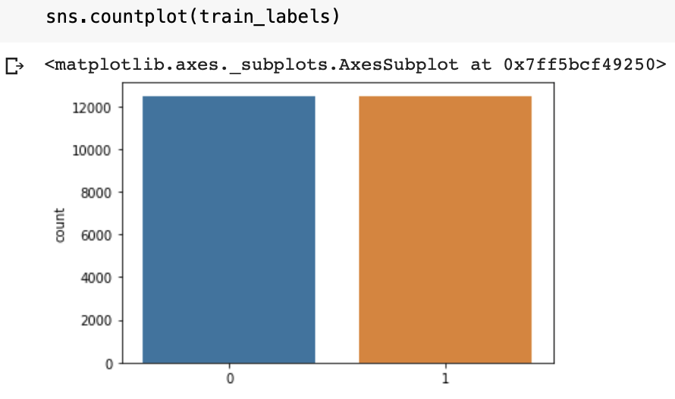
The Data
Checking if the Data is balanced
Normalizing the Data
By normalizing the pixel values of our images (dividing by 255) we achieve the state that is optimal to feed for our deep learning model to work on.

Slide 4
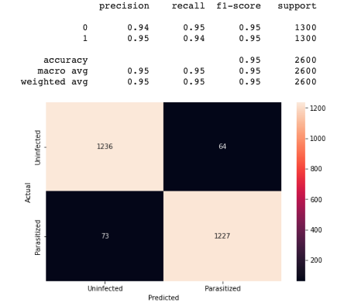
Objective
Maximizing Recall on Infected Cells class
Emphasis on minimizing the number of misclassified infected cells
Number of uninfected cells predicted to be infected not as important

Slide 5
Model Architecture

Slide 6
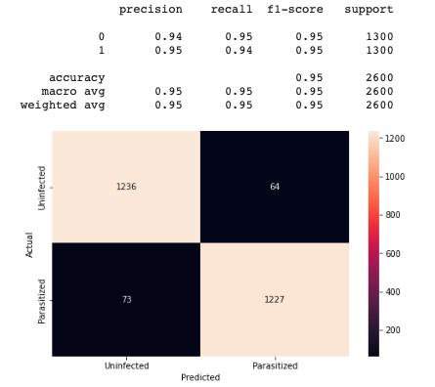
The Base Model
Features and Performance
3 convolutional layers, each followed by a MaxPooling2D and Dropout layer
Relu activation, adam optimizer
Performed Strongly, only misclassified 73 infected cells as uninfected
Train accuracy performed closely with validation accuracy, meaning no overfitting

Slide 7
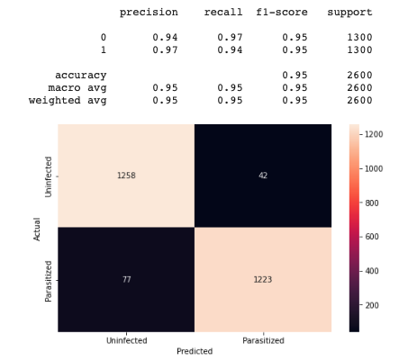
Adding Layers
Features and performance
Added another convolutional layer followed by MaxPooling2D and Dropout
Recall very slightly dropped for the infected class but improved considerably for the uninfected class.

Slide 8
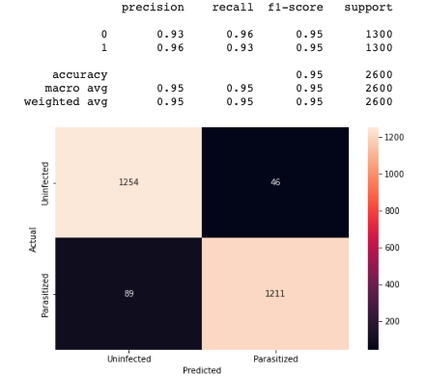
Batch Normalization and
LeakyReLu
Features and performance
Adding batch normalization and changing the activation function to LeakyReLu
Weakened performance on recall for infected cells class

Slide 9
Pre-Trained Model

Slide 10
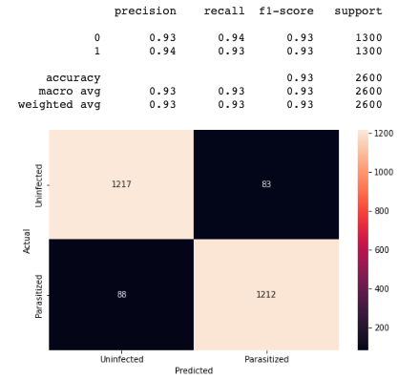
VGG16 model
Features and performance
This pre-trained model already has set hyperparameters and layers, so we tested to see how well it would perform on our images
Result: Decreased performance

Slide 11
Keras Tuner

Slide 12
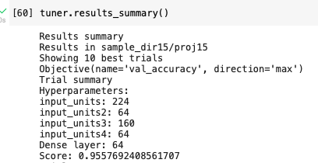
KerasTuner
Features
We used KerasTuner to find some optimal hyperparameters, i.e number of filters for each convolutional layer and for the dense layer

Slide 13
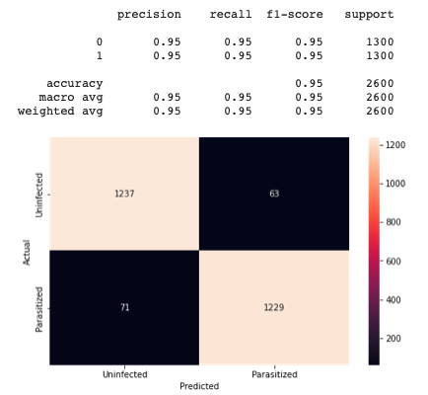
KerasTuner
Performance
After using these new hyperparameter values, we saw a slight improvement over our best model
From 73 misclassified infected cells to 71, and strong overall performance seen in the other metrics

Slide 14
Image Alterations

Slide 15
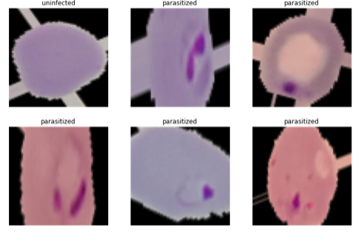
Image Augmentation
Performance
Very Strong at avoiding misclassification of uninfected class.
No improvement on infected class

Slide 16
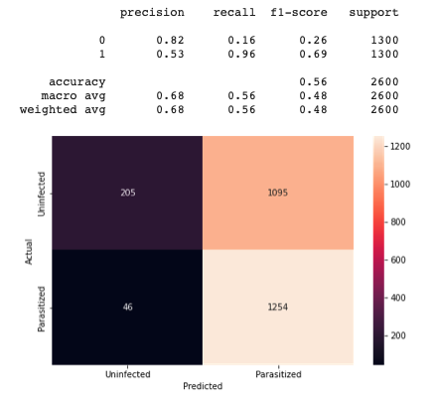
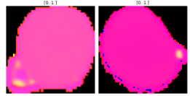
HSV conversion
Performance
Very strong recall performance on infected cells but extremely poor in other metrics.

Slide 17
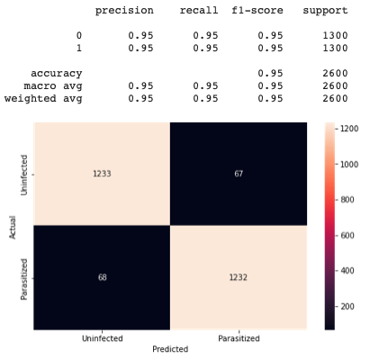
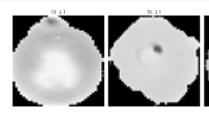
Grayscale
Performance
Our best performance so far

Slide 18
Conclusions

Slide 19
Best Model
Our Keras-tuned-model with grayscale image inputs gave the best results
When considering a healthy balance across all performance metrics with more emphasis on recall for infected class, this model performed the best. Another key benefit is that it removes noise.
Considerations
Potential Limitation: Grayscale images do not capture potential differences between cells with respect to colour. This should be considered when the model is provided with more data.
I.e new image shows a non-threatening characteristic that is a specific colour, which the model confuses for being infected

Slide 20
Further options to be explored
The following techniques may lead to even better results
Bayesian optimization instead of KerasTuner
Cross validation
Plotting the images to see which ones are being misclassified and try to understand why
Other types of image alterations
Other models?
ResNet: Trying another pre-trained model apart from VGG16 might give us a better result.
Transfer Learning: If we can find another model that performed very strongly on a similar dataset, then maybe we can use it and alter some of its features to fit our images.

Slide 21
Next steps
A well-planned pipeline: A good pipeline helps make our model implementation more flexible (Computation units become easier to replace), and gives us more control over the model.
Also gives us Extensibility(easy to create new functionality) and Scalability(if any part has an issue, we can scale that component separately)
Collaborating with the engineering team for deployment
Seamless transition from training to deployment requires strong communication with the engineering team
Processing thousands of images continuously presents more challenges than just reading a single dataset

